Slide 1
ARTIFICIAL INTELLIGENCE
CHAPTER 11: PLANNING
  Col Siddharth Malik, SM

Slide 2
The Story So Far…..
We studied how to take actions in the world (search)
We studied how to represent objects, relations, etc. (logic)
Now we will combine the two!

Slide 3
Why Planning?
Intelligent agents need to perform in real world
  Take intelligent actions
  Compose actions to achieve complex goals
Change the world to suit the needs
  Agents need to reason about the what the world would be after executing a sequence of actions world
  Need to reason about Dynamic environment

Slide 4
A Real World Planning Problem
Goal: “Have a birthday party”
Current Situation: Agent is @home, has flour, Does not have sugar, does not have butter
To Do List: invite friends, Buy butter, Buy sugar, bake a cake

Slide 5
Generating Plans
Given:
  A way to describe the world
  A initial state of the world
  A goal description
  A set of possible actions to change the world

Slide 6
Planning Algorithms & Planning Languaue
Planning algorithms should take advantage of logical structure of the problem
The problem should be expressed in suitable logical language
Language should be
  expressive enough to describe a wide variety of problems
  Restrictive enough to allow efficient algorithms on operate on it

Slide 7
Representing a Planning Problem
Representation of States
Representation of Goals
Representation of Actions

Slide 8
Modeling states
(STRIPS Language)
States are modeled in terms of propositions or state variables ex At(home), Hungry
  Complete initial state
  Final goal state
A state is a conjunction(AND) of positive literals
  morning AND hot AND humid AND dusty
  At(Robot1, Kitchen) AND At(Robot2, Kitchen)
Predicate
Literal

Slide 9
State of the world (STRIPS language)
State of the world = conjunction of positive, ground, function-free literals
At(Akib, Home) AND Is(Akib, Baking) AND Is(Akib, Hungry)
Not OK as part of the state:
  NOT(At(Akib, Home)) (negative)
  At(Akib, Home) OR Is(Akib, Baking) (Disjunction)
  At(Bedroom(Home)) (uses the function Bedroom)
Any literal not mentioned is assumed false
  Other languages make different assumptions, e.g., negative literals part of state, unmentioned literals unknown

Slide 10
Representing a Planning Problem
Representation of States
Representation of Goals
Representation of actions

Slide 11
Representation of Goals
Goal is
  Partially specified
  Represented as conjunction of literals
  Rich AND Famous AND Stays(Dhaka)
A state s satisfies goal g
  If s contains all the propositions of g
  Ex
    state- lighted AND hot AND brass
    Goal- lighted AND hot

Slide 12
Representing a Planning Problem
Representation of States
Representation of Goals
Representation of Actions

Slide 13
An action: Fly
Fly (p, from, to)
Preconditions: (-ve literals not allowed)
  Plane(p)
  Airport(from)
  Airport(to)
  At(p, from)
Effects (“NOT something” means that that something should be removed from state):
  NOT At(p, from) AND At(p, to)

Slide 14
Find a plan
Goal: At(Work) AND Dry
Initial state:
  At(Home) AND IsAt(Umbrella, Home) AND HandEmpty AND Dry

Slide 15
Action -1
TakeObject(Location, Object)
Preconditions:
  At(Location) AND Dry AND IsAt(Object, Location) AND HandEmpty
Effects:
  Holding(Object)
  NOT HandEmpty

Slide 16
Action - 2
WalkWithUmbrella(location1, location2, umbr)
Preconditions:
  At(location1)
  Holding(umbr)
Effects:
  At(location2)
  NOT(At(location1))

Slide 17
Action 3
WalkWithoutUmbrella(location1, location2)
Preconditions:
  At(location1)
Effects:
  At(location2)
  NOT(At(location1))
  NOT(Dry)

Slide 18
A goal and a plan
Goal: At(Work) AND Dry
Recall initial state:
  At(Home) AND IsAt(Umbrella, Home) AND HandEmpty AND Dry
TakeObject(Home, Umbrella)
  At(Home) AND Dry AND Holding(Umbrella)
WalkWithUmbrella(Home, Work, Umbrella)
  At(Work) AND Dry AND Holding(Umbrella)

Slide 19
Representing a Planning Problem
Representation of States
Representation of Goals
Representation of Actions

Slide 20
Modeling states
(STRIPS Language)
States are modeled in terms of propositions or state variables ex At(home), Hungry
  Complete initial state
  Final goal state
A state is a conjunction(AND) of positive literals
  morning AND hot AND humid AND dusty
  At(Robot1, Kitchen) AND At(Robot2, Kitchen)
Predicate
Literal

Slide 21
Representing a Planning Problem
Representation of States
Representation of Goals
Representation of actions

Slide 22
Representation of Goals
Goal is
  Partially specified
  Represented as conjunction of literals
  Rich AND Famous AND Stays(Dhaka)
A state s satisfies goal g
  If s contains all the propositions of g
  Ex
    state- lighted AND hot AND brass
    Goal- lighted AND hot

Slide 23
Representing a Planning Problem
Representation of States
Representation of Goals
Representation of Actions

Slide 24
An action: Fly
Fly (p, from, to)
Preconditions: (-ve literals not allowed)
  Plane(p)
  Airport(from)
  Airport(to)
  At(p, from)
Effects (“NOT something” means that that something should be removed from state):
  NOT At(p, from) AND At(p, to)

Slide 25


Blocks world
B
D
Blocks
A
C
Table
There are blocks and a robotic arm
Robotic arm can pick up only one block at a time
Only a block which has no other block on top of it can be picked up
You can place a block on top of a block which has no other block placed on it

Slide 26
Blocks world
B
D
A
C
Literals describing the states of the world
On(b, x) – Block b on Block x
Clear (x) – There is no block on Block x
Block(b) - b is a Block

Slide 27
Blocks world
B
D
A
C
Representation of state
On(B, A), On(A, Table), On(D, C), On(C, Table), Clear(B), Clear(D)
A state is a conjunction(AND) of positive literals hence (NOT Clear(A)) and (NOT Clear(C)) not mentioned

Slide 28

Blocks world: Move action
Y can be a block or table
Z cannot be a Table
B
D
A
C
E
Move(x,y,z) – specifies move amongst blocks and move of blocks on table to another block
Preconditions:
  On(x,y), Clear(x), Clear(z)
Effects:
  On(x,z), Clear(y), NOT(On(x,y)), NOT(Clear(z))

Slide 29
Blocks world: MoveToTable action
B
D
A
C
MoveToTable(x,y)- specifies move of blocks to table
Preconditions:
  On(x,y), Clear(x)
Effects:
  On(x,Table), Clear(y), NOT(On(x,y))

Slide 30
Blocks world example
C
B
D
B
A
C
A
Goal: On(B,A) AND On(C,B) AND Clear(C)
A plan: MoveToTable(D, C), Move(C, Table, B)

Slide 31
Blocks world example
B
D
A
C
Goal: On(A,B) AND Clear(A) AND On(C,D) AND Clear(C)
A plan: MoveToTable(B, A), MoveToTable(D, C), Move(C, Table, D), Move(A, Table, B)
Really two separate problems

Slide 32

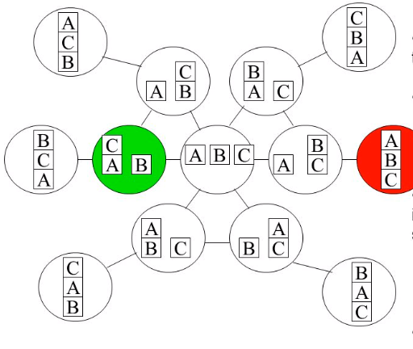
PLANNING WITH STATE SPACE SEARCH

Slide 33
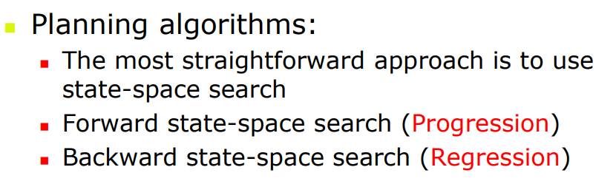
PLANNING WITH STATE SPACE SEARCH

Slide 34
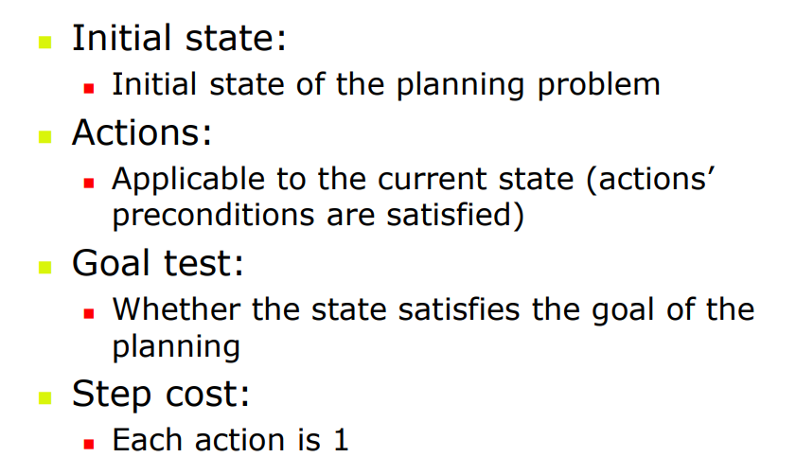
PROBLEM FORMULATION WITH PROGRESSION

Slide 35
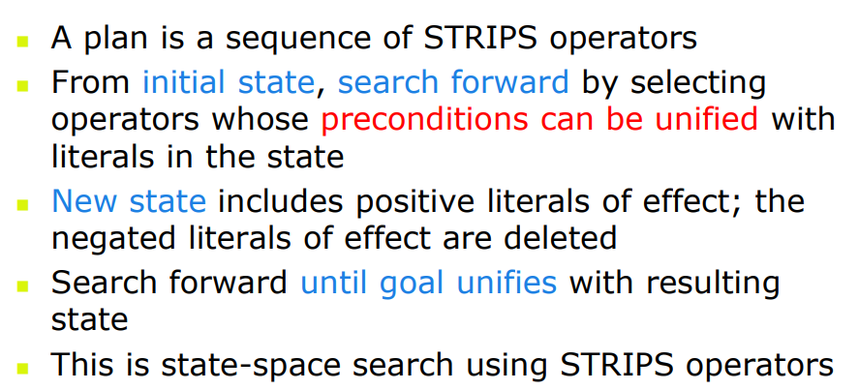
PROGRESSION

Slide 36
PLANNING WITH STATE SPACE SEARCH

Slide 37









PROGRESSION
Start
State
On(C, A), On(B, Table),
On(A, Table), Clear(B), Clear(C)
Action1
  Precondition
  Effects
Action2
  Precondition
  Effects
  -
  -
Action N
  Precondition
  Effects
State A
State B
State C
State D
State D
State E
State Z
Goal
State
On( A,B), On (B,C)
On(C, Table), Clear(A)

Slide 38
Forward state-space search (progression planning)
Successors: all states that can be reached with an action whose preconditions are satisfied in current state
At(Home)
Holding(Umbrella)
CanBeCarried(Umbrella)
IsUmbrella(Umbrella)
Dry
WalkWithUmbrella(Home, Work, Umbrella)
At(Work)
Holding(Umbrella)
CanBeCarried(Umbrella)
IsUmbrella(Umbrella)
Dry
TakeObject(Home, Umbrella)
WalkWithoutUmbrella(Home, Work)
At(Home)
IsAt(Umbrella, Home)
CanBeCarried(Umbrella)
IsUmbrella(Umbrella)
HandEmpty
Dry
GOAL!
At(Work)
IsAt(Umbrella, Home)
CanBeCarried(Umbrella)
IsUmbrella(Umbrella)
HandEmpty
WalkWithoutUmbrella(Work, Home)
At(Home)
IsAt(Umbrella, Home)
CanBeCarried(Umbrella)
IsUmbrella(Umbrella)
HandEmpty
WalkWithoutUmbrella(Home, Work)
WalkWithoutUmbrella(Home, Umbrella) (!)

Slide 39
PLANNING WITH STATE SPACE SEARCH

Slide 40
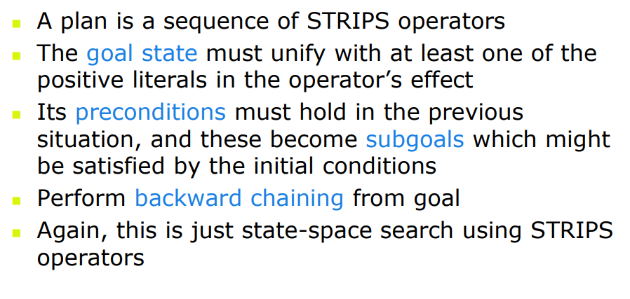
REGRESSION

Slide 41




REGRESSION
Start
State
On(C, A), On(B, Table),
On(A, Table), Clear(B), Clear(C)
Action1
  Precondition
  Effects
Action2
  Precondition
  Effects
  -
  -
Action N
  Precondition
  Effects
State A
State Z
State Y
State X
Goal
State
On( A,B), On (B,C)
On(C, Table), Clear(A)

Slide 42
Backward state-space search (regression planning)
Predecessors: for every action that accomplishes one of the literals (and does not undo another literal), remove that literal and add all the preconditions
TakeObject(location2, umbr)
WalkWithUmbrella(location1, Work, umbr)
At(location1)
At(location2)
IsAt(umbr, location2)
CanBeCarried(umbr)
IsUmbrella(umbr)
HandEmpty
Dry
At(location1)
Holding(umbr)
IsUmbrella(umbr)
Dry
At(Work)
Dry
GOAL
WalkWithUmbrella(location2, location1)
This is accomplished in the start state, by substituting location1=location2=Home, umbr=Umbrella
WalkWithoutUmbrella can never be used, because it undoes Dry
(this is good)

